Slide 1
APIs 2 Authentication
Andrew Beatty
Andrew.Beatty@gmit.ie
Programming for Cybersecurity

Slide 2
Authentication (why OAUTH2)
Some use-cases:
It is your resource, (eg Gmail account) and you are accessing it from some server
In this case you don’t mind your code having a permanent (semi) key that will tell the resource that the program has authority.
This can be called an API key or access token
It is your resource, but the program is being run from a website (Javascript)
You do not want the identifier to be permanent, so you use an permanent key on a server to generate a temporary access token and pass this to the website.
Your code is going to be run by someone else, who trusts you:
Your program gets the user name and password from the user, log into the resource and get an access token.
Your code is going to be run by someone else, who does not trust you:
Your program redirects the user to the resource,
they log onto the resource
and the resource calls a webhook, with an access token that your program can use

Slide 3
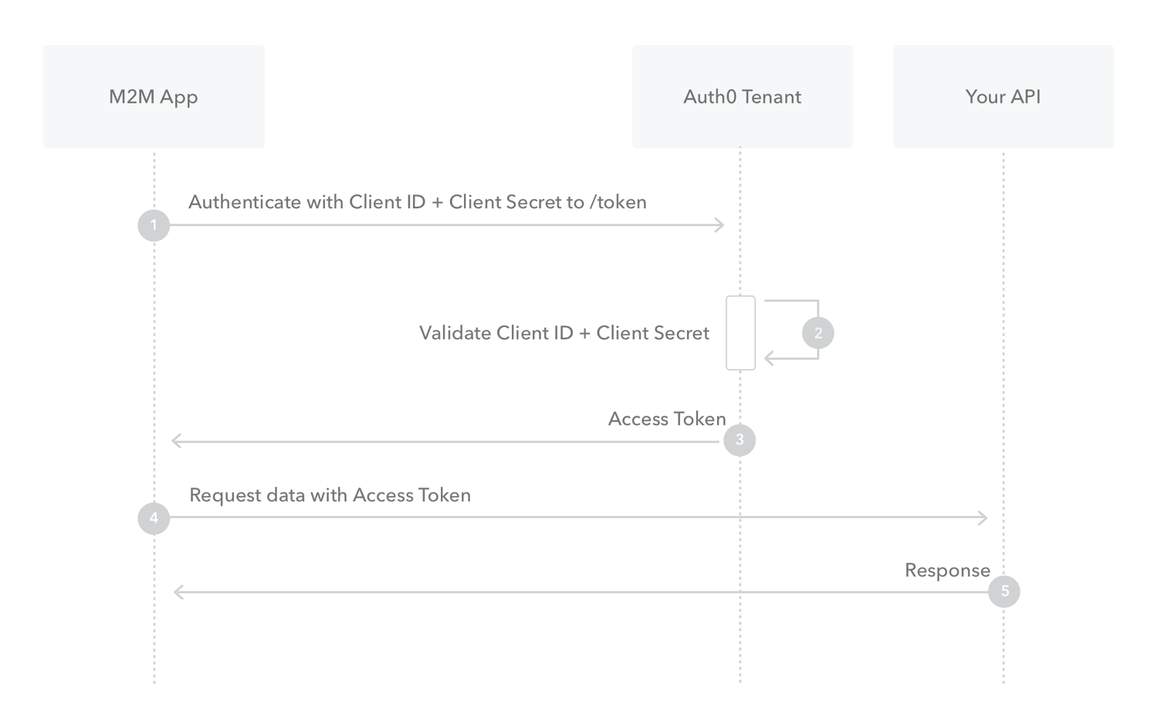

Slide 4
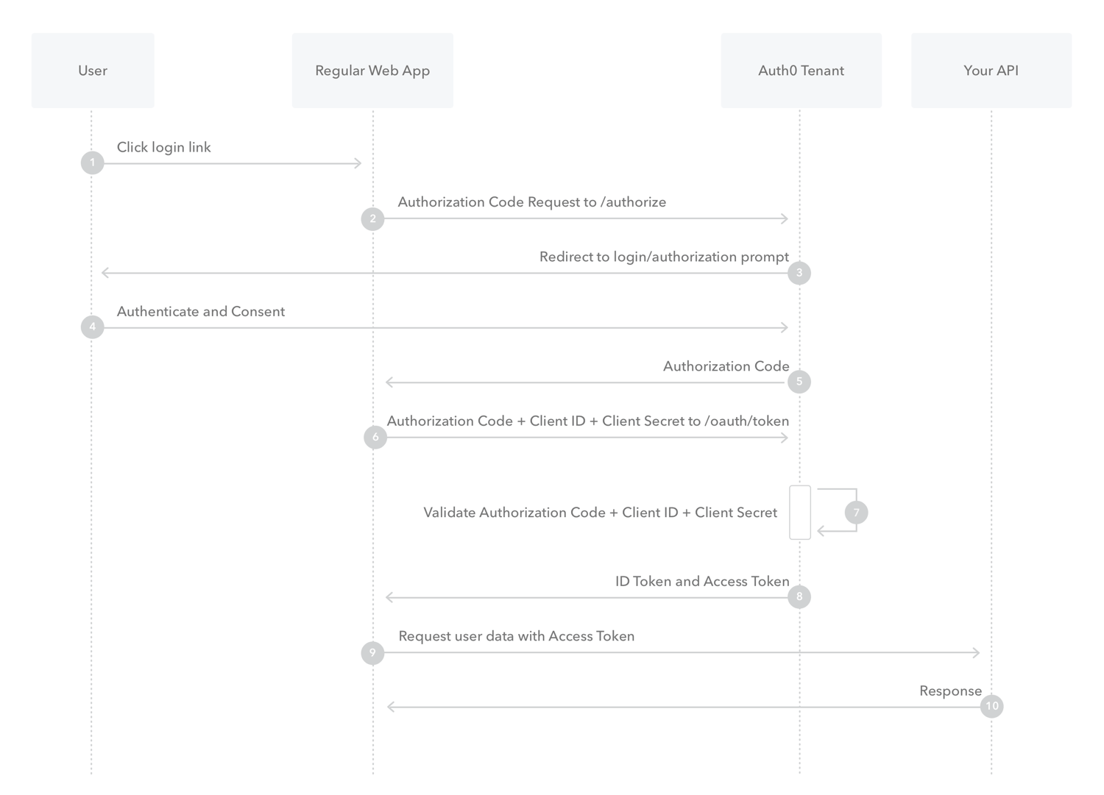

Slide 5
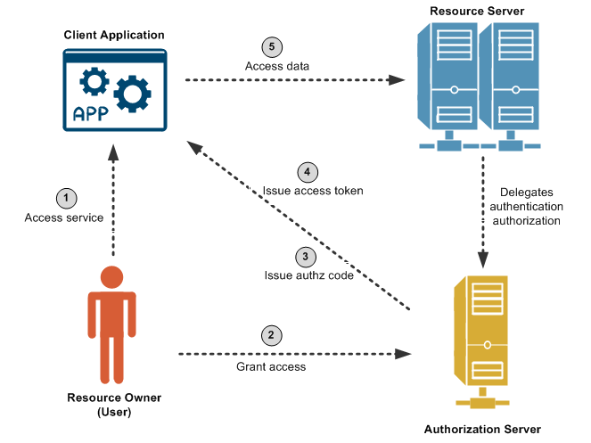

Slide 6
In practice
Get the api key/ token
Do not store the key in a file that is going to uploaded to github
Include it into our headers (or pass to client module)
Banks can be a bit more convoluted

Slide 7
HTTP and JSON
Database
Client Machine
Server
PUT /books/123
Authorization: keyhere
Content: {“id”:123,
“title”:”order of phoenix” }
Client side module
(you sometimes have to write this)
A web server
(That implements the API)
Your code
network
Response 200 ok
Content: {“id”:123,
“title”:”order of phoenix”
“ISBN”:”123 456 789”

Slide 8
Example with Github to commit a file
Go to github, “create an application” and copy the secret key
Set the permissions you want that application to have
Use that key in the header of your request
Set the authorization value to the key
Make the call like you did already
Be aware of Rate Limits

Slide 10
Stretch

